Slide 1


Michael Ames
Wake Forest
School of Business
_______
Bootcamp Day 1

Slide 2
Course Goal
The goal of this course is to introduce you to the python programming language and notebooks while assuming no prior coding knowledge or experience.

Slide 3

About Me.
Mike Ames
Professor of the Practice
Former: Sr. Research Science Manager at AWS
Former: Head of Emerging Technology & Data Science at SAS
Current ML / AI Consultant Specializing in
Fraud Detection & Prevention for Financial Services
Anti-Money Laundering Program Optimization
Computer Vision for Identity Verification
Graph Methods for Social Network Targeting
Large Language Models & AI
Hobbies
Kickboxing/BJJ/Judo; Mountain & Dirt Biking; Archery & Sporting clays, Photography

Slide 4
Where does python fit in the MSBA?
Probability and Statistical Modeling
Visual Analytics and Influencing
Analytics Software Technology
Data Management
Predictive Analytics, Forecasting & Data Mining
Prescriptive Analytics
Machine Learning
Career Management
Practicum 1 - 4
Analytics in Society
Marketing Analytics
Financial & Risk Analytics
"Python has been an important part of Google since the beginning and remains so as the system grows and evolves. Today dozens of Google engineers use Python, and we're looking for more people with skills in this language." - Wes McKinney

Slide 5
Python Data Science / Analytics Framework
Transform
Model
Visualize
Clean
Import
Communicate

Slide 6
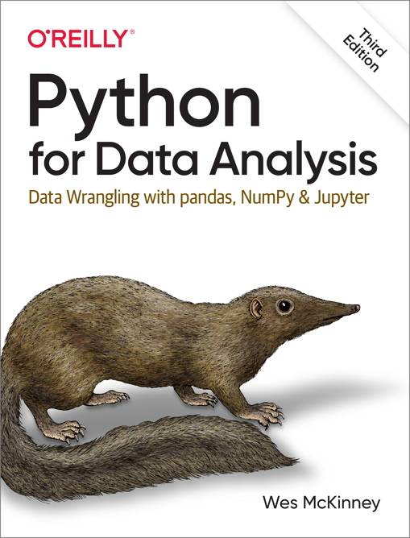
Our Book
GET THE BOOK!
https://wesmckinney.com/book/
Publisher ‏ : ‎ O'Reilly Media; 3rd edition (September 20, 2022)
Author : Wes McKinney
Language ‏ : ‎ English
Paperback ‏ : ‎ 579 pages
ISBN-10 ‏ : ‎ 109810403X
ISBN-13 ‏ : ‎ 978-1098104030 AMAZON LINK

Slide 7
Why code?
Data!
Analysis!
Automation!
Collaboration!
Market Demand!
Machine Learning and AI!
"Everybody in this country should learn how to program a computer because it teaches you how to think." - Steve Jobs

Slide 8
What We’ll Cover
Python Basics and beyond
Google Stuff:
Google Collaboratory
Google Drive
Google Sheets & Excel
Basic Analysis w. Python and Pandas
Import / Export Data
Eyeballing
Select / Query & Filter
Summary Statistics
Visualizations
Histogram
Box Plots
Line charts
Bar Charts
DEBUGGING
"Learning to code unlocks the ability to create and innovate, empowering individuals to shape the future and solve the world's most pressing challenges." - Satya Nadella, CEO of Microsoft

Slide 9
Course Design
In Class
Short lessons
Follow-along interactive exercises
Out of Class
Review Notebooks
Discussion Boards
Review of Daily Materials
"Whether you want to uncover the secrets of the universe, or you just want to pursue a career in the 21st century, basic computer programming is an essential skill to learn." - Stephen Hawking

Slide 10
Expectations
You can expect that this will be challenging!
You can’t learn to code overnight. It’ll take deliberate practice and much trial and error.
Read slowly and go step-by-step.
The instructions in the coding notebooks may feel overwhelming at first. Read them slowly, and if you’re overwhelmed, go step-by-step to try and solve a problem or get as far as you can.
Be open and curious in the course.
Try things out, type them into the console and see what happens, try extending beyond the exact materials taught. Many learn best by experimenting and exploring.

Slide 11
Day 1 Agenda
Google Colabratory
Your first notebook!
Google Drive
Basic Python
Print
Numbers
Strings
Wrap Up
"Technology is nothing. What's important is that you have a faith in people, that they're basically good and smart, and if you give them tools, they'll do wonderful things with them." - Steve Jobs

Slide 12

Day 1 Goals
Able to recognize and open a Notebook from Google Drive
Run lines of python code in a notebook
Create and manipulate numeric and string variables
Use print() to output a variety of results.

Slide 13
Overview of Python and its applications
Python is an interpreted language. The Python interpreter runs a program by executing one statement at a time.
Why Python?
General-purpose programming language
Simple and readable syntax
Extensive library ecosystem for various tasks
Python is the language of Cloud Computing, Analytics, Machine Learning and AI
Why Notebooks?
Interactive and Exploratory Data Analysis
Documentation and Reproducibility
Collaboration and Communication

Slide 14
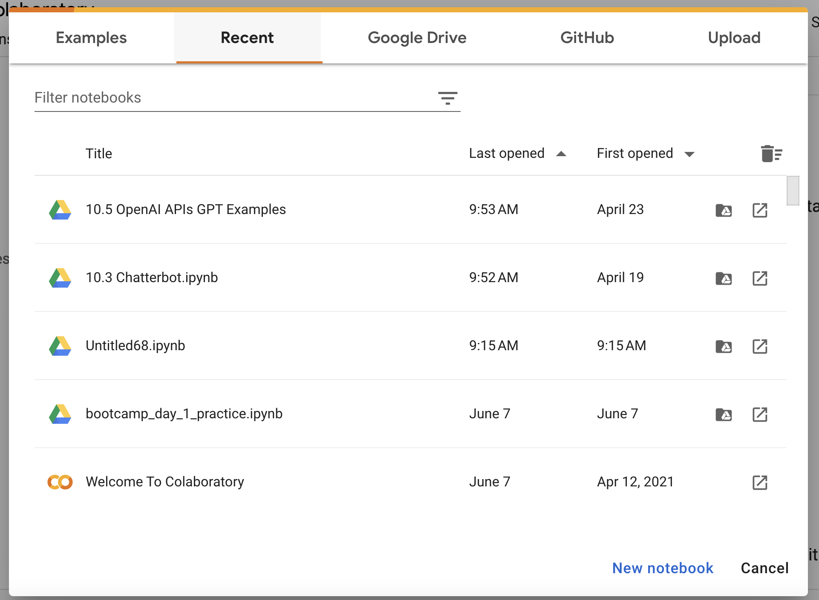
Google Colabratory & Notebooks
https://colab.research.google.com/
Google Colaboratory(Colab) - cloud-based Jupyter notebook provided by Google.
Key Features:
Cloud-based: Colab runs on Google's cloud infrastructure, allowing users to access computational resources without the need for local installations or setups.
Free Access: Colab is available for free, wide range of pre-installed libraries and tools
Interactive Notebooks: Colab provides a Jupyter notebook interface that supports code execution, documentation, and visualizations in a single environment.
Integration with Google Services: Colab integrates with Google services : Google Drive, Google Sheets, and more.

Slide 15

Make a New Notebook
In a browser
Go to colab.research.com
Click New Notebook
5 Minutes

Slide 16
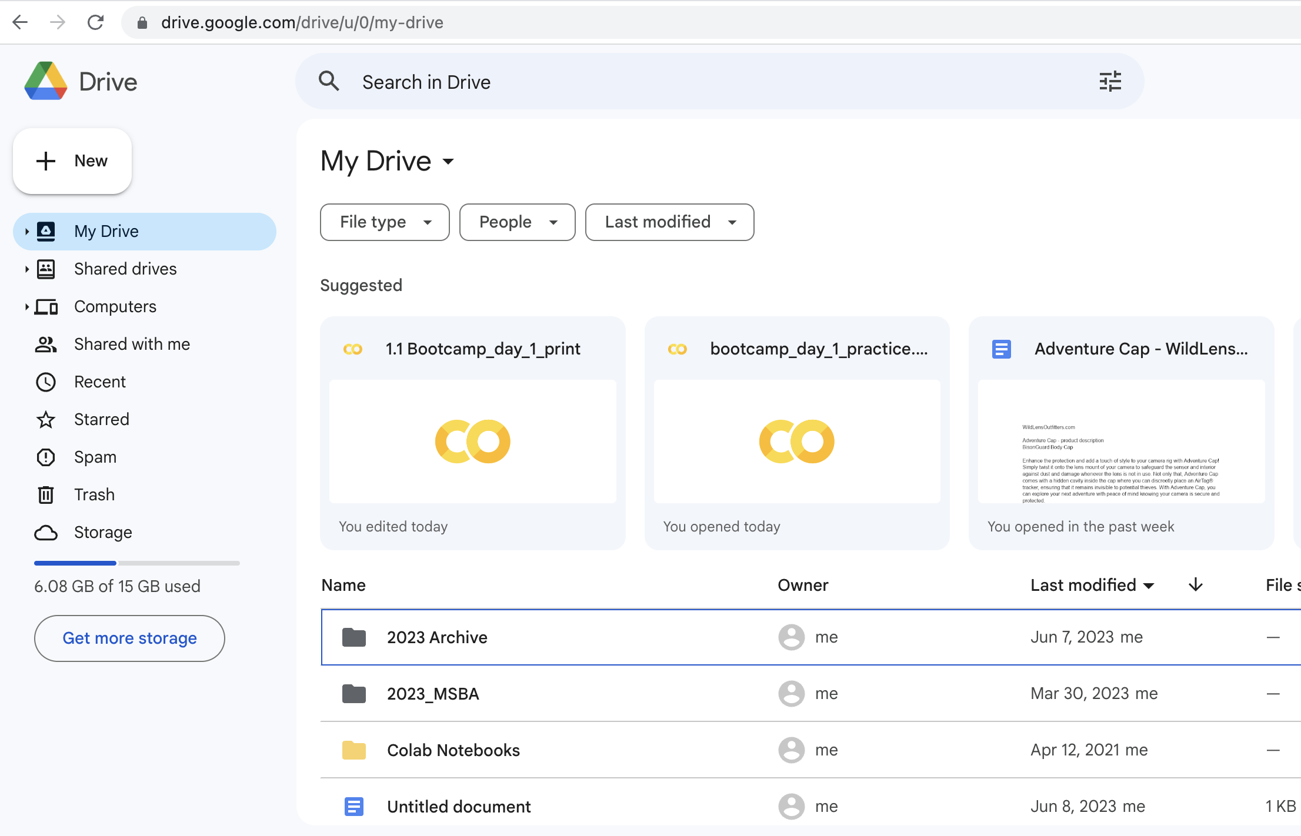
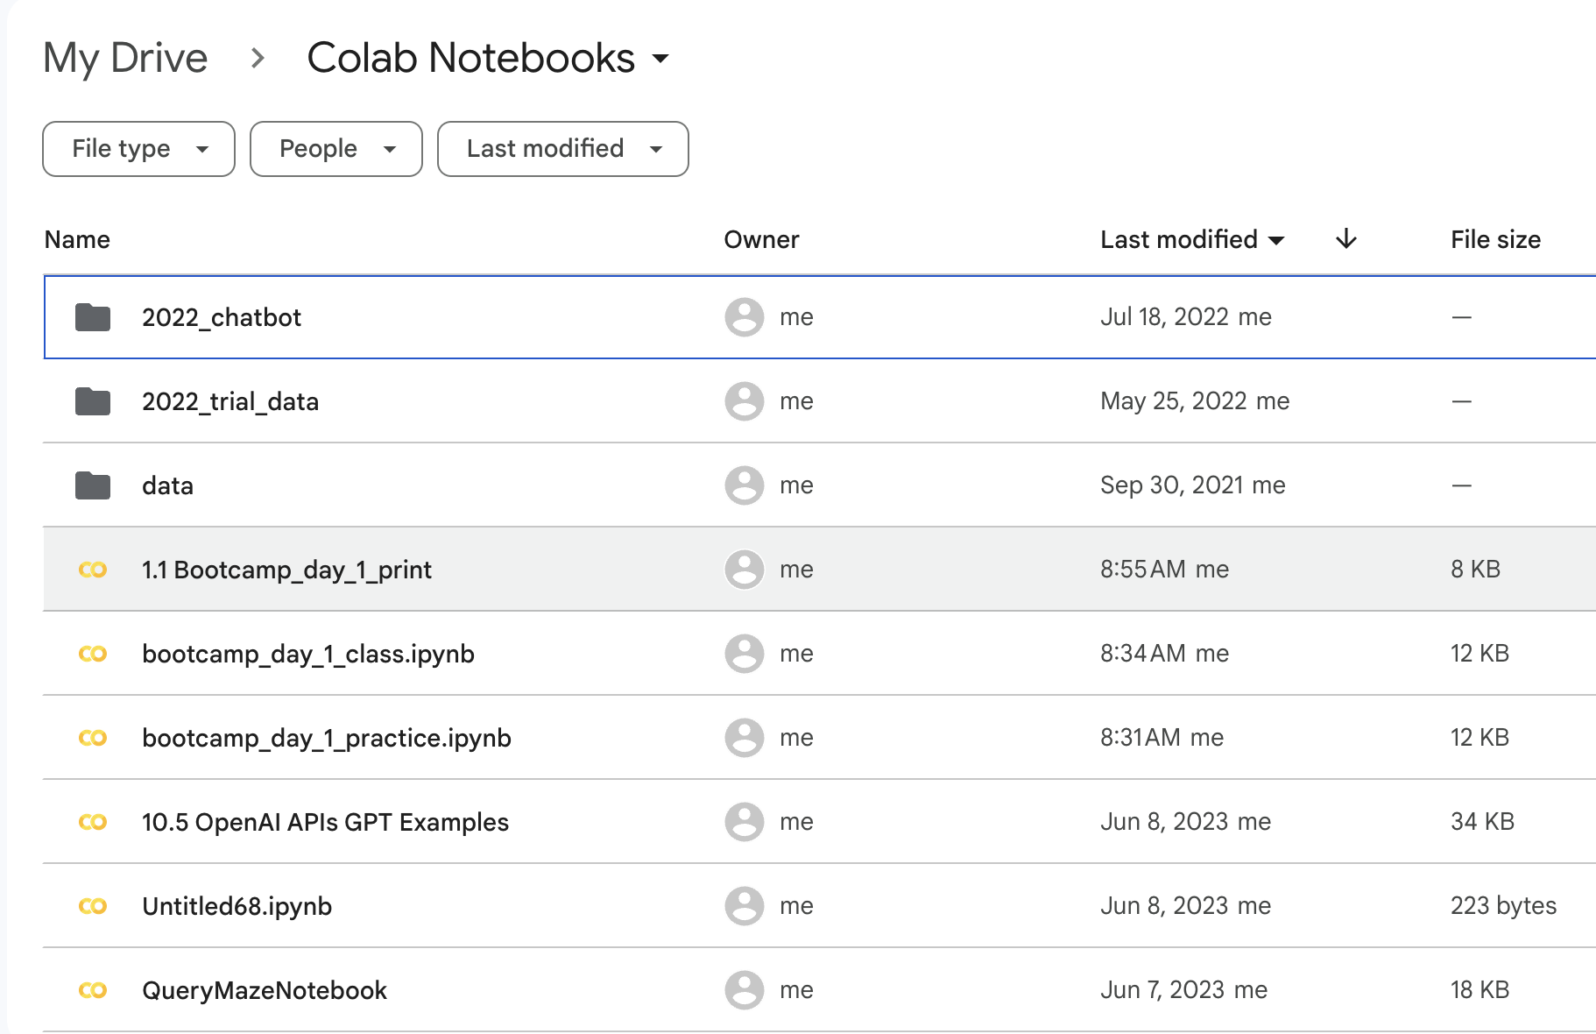
Google Drive
https://drive.google.com/drive
Notice Colab Notebooks folder

Slide 17
The print() function
print() function
The print function is used to display output in Python.
It allows you to output text, variables, and expressions to the console.
print(object(s), sep=' ', end='\n', file=sys.stdout, flush=False)
object(s): One or more objects to be printed.
sep=' ': Separator between the objects (default is a space).
end='\n': Ending character (default is a newline).
file=sys.stdout: Output file (default is the console).
flush=False: Controls flushing the output buffer (default is False).
print(“Hello, World!”)
Hello, World!

Slide 18
Print examples
print("Hello, World!") # Output: Hello, World!
print("Number:", 42) # Output: Number: 42
print("Value:", 3.14, "PI") # Output: Value: 3.14 PI
print("Hello", "World", sep='-') # Output: Hello-World
print("Hello", end=' ') # Output: Hello (without newline)
print("World!") # Output: World! (on the same line)

Slide 19
Open: 1.1 bootcamp_day_1_print.ipynb
5 Minutes

Slide 20
Number Data Types in Python
Python supports several number data types, including:
Integer (int): Whole numbers without decimal points.
Floating-point (float): Numbers with decimal points.
Integer Data Type
Integers represent whole numbers without decimal points.
Example: x = 42
Floating-Point Data Type
Floating-point numbers represent numbers with decimal points.
Example: y = 3.14

Slide 21
Arithmetic Operations
Python supports various arithmetic operations on numbers:
Addition: x + y
Subtraction: x - y
Multiplication: x * y
Division: x / y
Exponentiation: x ** y
Modulo: x % y
# Addition
x = 5 + 3
print("Addition:", x) # Output: 8
# Subtraction
y = 10 - 2
print("Subtraction:", y) # Output: 8
# Multiplication
z = 4 * 5
print("Multiplication:", z) # Output: 20

Slide 22
Data Type Conversion
Python allows you to convert between different number types:
Integer to float: float(x)
Float to integer: int(y)
# Float to integer
y = 3.14
int_y = int(y)
print("Float to integer :", int_y) # Output: 3
# String to Integer
z = "50"
int_z = int(z)
print("String to Integer :", int_z ) # Output: 50

Slide 23
Open: 1.2 bootcamp day1 numbers and arithmetic
5 Minutes

Slide 24
Strings in Python
Strings are a fundamental data type in Python.
They represent sequences of characters enclosed in single quotes ('') or double quotes ("").
Examples: "Hello", 'Python', "123”
# Create a string
message = "Hello, Python!"
# Print the string
print(message)

Slide 25
String Operations
Concatenation: Combining two or more strings using the + operator.
Repetition: Repeating a string multiple times using the * operator.
Accessing Characters: Accessing individual characters within a string using indexing.
Slicing: Extracting substrings from a string using slicing syntax.

Slide 26
Input() in Python
The input() function is used to accept user input in Python.
It prompts the user to enter a value and returns the entered value as a string.
name = input("Enter your name: ")
print("Hello, " + name + "!")

Slide 27
Concatenation
The `+` operator concatenates (joins) two strings together.
greeting = "Hello"
name = "Alice"
message = greeting + ", " + name
print(message) # Output: Hello, Alice

Slide 28
Repetition
The ‘*’ operator repeats a string a specified number of times.
text = "Python"
repeated_text = text * 3
print(repeated_text) # Output: PythonPythonPython

Slide 29
Accessing Characters
Strings are 0-indexed, meaning the first character is at index 0.
word = "Python"
first_character = word[0]
print(first_character) # Output: P
Slicing [start:end]
Slicing allows you to extract a substring by specifying start and end indices.
phrase = "Hello, World!"
substring = phrase[7:12]
print(substring) # Output: World

Slide 30
Common String Methods
Python provides several built-in methods to manipulate strings:
len(): Returns the length of a string.
lower(), upper(): Converts a string to lowercase or uppercase.
split(): Splits a string into a list of substrings based on a delimiter.
strip(): Removes leading and trailing whitespace from a string.
str(): converts numbers to a string
text = " Python is Fun! "
print(len(text)) # Output: 18
print(text.lower()) # Output: python is fun!
print(text.upper()) # Output: PYTHON IS FUN!
print(text.split()) # Output: ['Python', 'is', 'Fun!']
print(text.strip()) # Output: Python is Fun!

Slide 31
Open: 1.3 bootcamp_day_1_strings
5 Minutes

Slide 32
Formatting Output
Python provides various techniques to format the output:
Concatenation
Concatenation allows you to combine strings using the + operator.
You can concatenate strings with variables or other strings.
name = "Alice"
age = 25
print("My name is " + name + " and I am " + str(age) + " years old.")

Slide 33
F-string - String Interpolation
F-strings (formatted string literals) provide a concise and convenient way to embed variables and expressions within strings.
They are created by prefixing a string with the letter 'f' or 'F'.
Inside an f-string, you can directly embed variables or expressions within curly braces {}.
name = "Alice"
age = 25
print(f"My name is {name} and I am {age} years old.")
”f” says format this string
”{name}” fill in the value of name here
”{age}” fill in the value of age here – note don’t need to convert to a string

Slide 34
.format(variable) – String Interpolation
The format() method provides a flexible way to format strings.
You use placeholders “{}” within a string and call the format() method to replace them with values.
name = "Alice"
age = 25
print("My name is {} and I am {} years old.".format(name, age))
”{}” placeholder for var1
”{}” placeholder for var2
format() method replaces placeholders in the strings with variables based on position

Slide 35
Formatting Numbers for Print
F-strings
Using f-strings
F-strings also support formatting options for numbers:
:.nf: Formats a float number with n decimal places.
:,.0f: Formats a float number with comma as a thousands separator and no decimal places.
pi = 3.14159
population = 1000000
print(f"Pi: {pi:.2f}")
print(f"Population: {population:,.0f}")

Slide 36
Formatting numbers for Print
.format() method
When printing numbers, you can apply formatting options to control how they are displayed. Python provides several ways to format numbers:
Using the format() Method
The format() method allows you to format numbers within a string by specifying formatting directives:
{:.nf}: Formats a float number with n decimal places.
{:.2f}: Formats a float number with 2 decimal places.
{:,}: Adds comma as a thousands separator for integer or float numbers.
pi = 3.14159
population = 1000000
print("Pi: {:.2f}".format(pi))
print("Population: {:,}".format(population))

Slide 37
Dealing with Percentages
Suppose I have a number like .9023 and I want to print it as 90.23% how do I do that?
Use the format specifier :.2% ~ number as a percentage with two decimal places.
: indicates the beginning of the format specifier.
.2 specifies the precision, indicating that the number should be formatted with two decimal places.
% is the percentage sign itself, which denotes that the number should be formatted as a percentage.
number = 0.8023
formatted_percentage = "{:.2%}".format(number)
print(formatted_percentage)
formatted_percentage = f"{number:.2%}"
print(formatted_percentage)

Slide 38
Open: 1.4 bootcamp_day_1_formatting
5 Minutes

Slide 39
Booleans & Comparisons
Booleans
Booleans are a data type in Python that represent the concept of truth.
They can have two values: True or False.
Booleans are used in conditionals to make decisions and control the flow of a program.
Comparison Operators
Comparison operators are used to compare values and return a boolean result.
Common comparison operators in Python include:
== (equal to)
!= (not equal to)
> (greater than)
< (less than)
>= (greater than or equal to)
<= (less than or equal to)

Slide 40
Conditional Statements: if, elif, else
Conditional Statements
Conditional statements allow you to execute different blocks of code based on certain conditions.
In Python, conditional statements are written using the if, elif (else if), and else keywords.
if condition:
# Code block to execute if condition is True
statement_1
statement_2
...
else:
# Code block to execute if condition is False
statement_a
statement_b
...

Slide 41
Logical Operators
Logical operators are used to combine and manipulate boolean values.
Common logical operators in Python include:
and: Returns True if both conditions are True.
or: Returns True if at least one condition is True.
not: Negates the boolean value (returns the opposite).
temperature = 25
humidity = 70
if temperature > 30 and humidity > 60:
print("It's a hot and humid day.")
elif temperature > 30 or humidity > 60:
print("It's either hot or humid.")
else:
print("It's neither hot nor humid.")

Slide 42
Conditionals cont.
score = 85
if score >= 90:
grade = "A"
elif score >= 80:
grade = "B"
elif score >= 70:
grade = "C"
else:
grade = "D"
print("Grade:", grade)
Conditional statements allow for different code execution based on conditions.
if statements execute code when a condition is True.
if-else statements provide an alternative code block when the condition is False.
if-elif-else statements check multiple conditions and execute the code block based on the first condition that evaluates to True.
TABs

Slide 43

Tabs over Spaces
In Python, tabs (or spaces) are used for indentation and play a crucial role in defining the structure and scope of code blocks. Here are the reasons why tabs (or spaces) are important in Python:
Code Readability: Indentation using tabs or spaces enhances code readability. It makes the code structure clear and helps to visually understand the logical flow of the program.
Block Delimiters: Unlike other programming languages that use curly braces or keywords to delimit code blocks, Python uses indentation. It means that the level of indentation determines the grouping of statements within a code block.
Nesting: Python allows nesting of code blocks within other code blocks. Indentation levels help in maintaining the hierarchy and readability of nested structures such as if statements, loops, and function definitions.
Consistency and Best Practices: The Python community follows the Python Enhancement Proposal (PEP) 8, which is the official style guide for Python code. PEP 8 recommends using spaces for indentation and suggests using 4 spaces per indentation level. Consistent indentation throughout the codebase ensures better collaboration and code maintainability.

Slide 44
Open: 1.5 bootcamp_day_1_conditionals
5 Minutes

Slide 45
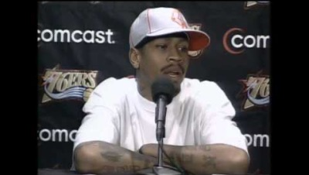
Practice
1.6 bootcamp pratice.ipynb
bootcamp_day_1_practice.ipynb
https://github.com/MonkeyWrenchGang/PythonBootcamp/blob/main/day_1/1_7_python_print_and_arithmetic_reivew.ipynb

Slide 46
Transform
Model
Visualize
Clean
Import
Communicate

Slide 47


